Slide 1


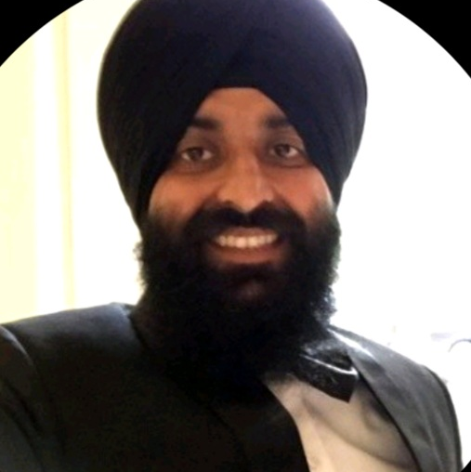
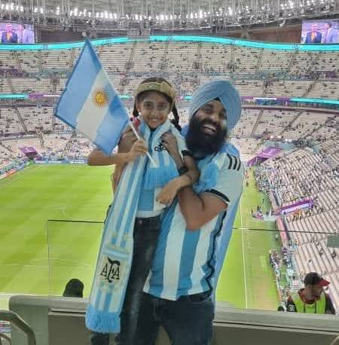
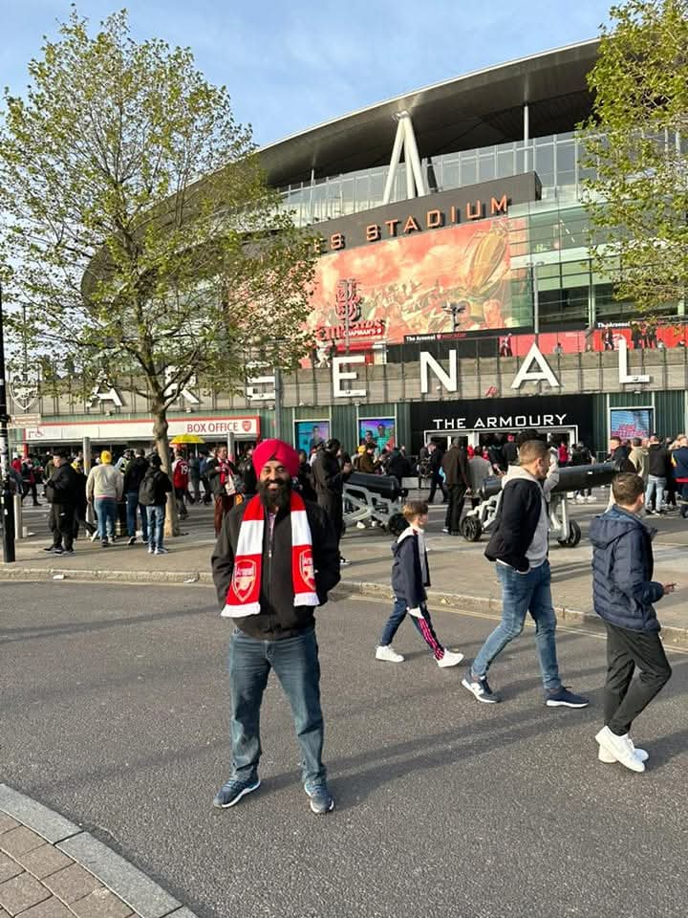
Getting to Know Me
Work
Personal
My role
Country Head, ofi Nigeria
Significant others / family members / furry friends in my life
My Wife and Kids and my extended family
Tenure in ofi/Olam
13 years
How I enjoy spending my free time
Spending time with family, watching & playing sports
Previous companies I have worked at
infosys
My favorite / comfort food
Chapati
Why I joined ofi/Olam and what keeps me here?
Looking for a new challenge, I stay because I have seen meaningful growth in and across my team members.
My favorite song
Most of Davido's songs
Inderjit Singh
‘what name you prefer to be called”
Inder
A few fun facts about me
I once played badminton and sprained my leg but still got on the badminton court the next day
This is me outside work, doing stuff I enjoy in my life …

